Slide 1

ALTSCHOOL OF
DATA ANALYSIS
CAPSTONE PROJECT REPORT
ON
SAKILLA MOVIE RENTAL
By: OJOH CHIEMELE DAVID
MAT NO: ALT/SOD/023/0702

Slide 2


Agenda
OVERVIEW
Introduction
METHODOLOGY
Steps taken, tools used to perform EDA and to execute the entire Project
INSIGHTS
Data driven insights from the project with visualization
RECOMMENDATIONS
Conclusion, useful recommendations

Slide 3
PROJECT OVERVIEW
CLIENT: SAKILLA RENTING MOVIES Inc.
TASK
Our client is a global movie rental chain with over 600 Loyal Customer base, across the 6 continents ( North & South America, Europe, Asia, Africa and Australia), with its main Head Quarter located in Jacksonville, Florida USA.
With a view of improving and expanding their Business Chain and Assets across the globe, our company “David Analytics” was engaged and tasked to carry out in depth analysis on their business for the last 2years, identify areas for improvements, Customer’s geographical locations with higher investments opportunities judging from customer demands and revenue generated, locations with lower revenue and high customer churn.
Give insightful and actionable recommendations on how to gain new customers, measures to retain old customers by improving customer services and maximize profit overall across all their Business Assets.

Slide 4
PROJECT METHODOLOGY
DATA SOURCE
The Dataset used for the project is Sakilla.db an SQLite database file provided by ALTschool as one of 3 Databases students are to chose from for our Capstone project.
DATA EXTRACTION
Microsoft Power BI was the tool of choice used for Data Modeling, Cleaning, Transformation and visualization. The dataset was imported into Power Bi using SQLite ODBC driver connector and consists of 15 tables; Actors, Film, Customers, Staff, Category, Payment etc.
DATA MODELING
Transformation and Modeling of the entire dataset was done using the Power Query Editor on Power BI, by going through each table column after another, the unnecessary columns and rows were deleted, checked for duplicates in all 15 tables, Merged tables that had unique identifiers (Primary & Secondary keys) so as to reduce the number of tables that will be needed for visualization and also reduce the overall size of the entire dataset/project. Renamed some columns for easy understanding, checked each column setting to ensure the appropriate data type for each of them, all these processes are just to eliminate complexity and ensure data accuracy.
The transformed dataset was loaded into the Power BI visualization page, now consisting of only 4tables (Customer, Film, Rental and Payment Tables) into the power bi work area, with 2 extra tables (Movie inventories and Top customers Table) gotten from my SQLite queries that I are needed for the overall analysis of the dataset.
4

Slide 5
PROJECT METHODOLOGY
DATA VISUALIZATION
Basic statistics were performed by creating Measures to get Average Rental Period, Profit, Profit %, Sales etc.
A useful and interactive visualizations/dashboard was created by use of Column, Doughnut, Gauge charts, KPI, Matrix, Tree Maps, Cards, Decomposition Trees etc. to uncover valuable insights from the data following Used Cases provided by the client (SAKILLA RENTING MOVIES Inc.) which includes;
Top-Rented Movies: Identify the most frequently rented movies and analyze the rental patterns by customer demographics.
Customer Rental Behavior: Segment customers based on their rental history and identify high-value segments.
Revenue Analysis: Evaluate revenue over time, broken down by categories such as genres, ratings, and customer segments.
Inventory Management: Assess the availability and turnover of DVDs, and provide recommendations for optimizing inventory levels.
Churn Analysis: Identify factors that contribute to customer churn and predict which customers are likely to churn.
Rental Duration Analysis: Analyze rental durations to identify trends and anomalies, and correlate them with customer satisfaction and revenue.
NOTE: The main types of visual used for this project were KPI cards to display the business Numbers and the TREE MAP due to its ability to accurately compare many data points with different categories unlike Pie and Doughnut charts that can typically accommodate a maximum of 5categories.
5

Slide 6
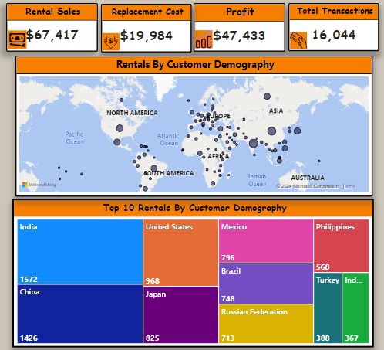
ANALYSIS & INSIGHTS
Business and Revenue Performance
From the careful analysis carried out on the business data provided by our client, it clearly shows a good and healthy business activity across all Her Assets around the globe particularly in India, China, USA, Japan and Mexico to name a few with high customer patronage and revenue output.
A total of 16,044 rental transaction was carried out, with a Gross Revenue of $67,417, Replacement/Maintenance cost of $19,984 and a Net profit of $47,433 which shows 70.36% interest of the Gross Revenue for the period under review.
This high profit margin is traceable to a Good Customer Relationship, Quality of service delivery, Low Replacement cost, Good Inventory & Maintenance culture and the overall High Standard of business operation our Client is reputed for over the years.
See Visuals for clearer understanding

Slide 7
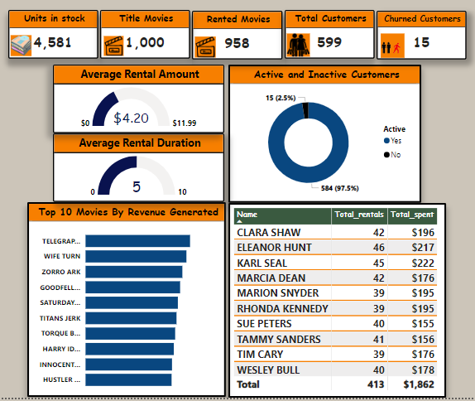
ANALYSIS & INSIGHTS
Business Analysis Cont.
The business owns a total of 1000 titled movies and their different genre/categories, with 4581 copies in inventory stock across Her business assets.
The analysis shows that 958 out of the 1000 titled movies are in demand and frequently rented, which means that the other 42 have not been rented or demanded by a customer for the period under review.
Movies Like Telegraph Voyage, Wife Turn, Zorro Ark etc. are amongst the top 10 revenue generating movies, which indicates high customers satisfaction.
Customer Churn Analysis
15 Customers were identified to have totally stopped using Sakilla Rental services, either due to relocation to areas with little or no access to Sakilla stores, found new hobbies, thus they no longer have a need to rent or watch movies or they generally decided to patronize new rental stores that suits their personal needs better.
Customers Rental Behavior
Karl Seal, Eleanor Hunt, Clara Shaw and Sue Peters are amongst the High Value Customers as they make frequent rentals leading to higher revenues from their continuous patronage.
The 5days average rental period indicates customer satisfaction hence the need to rewatch them for several days, irrespective of the additional rental charges.
See Visuals for clearer understanding

Slide 8
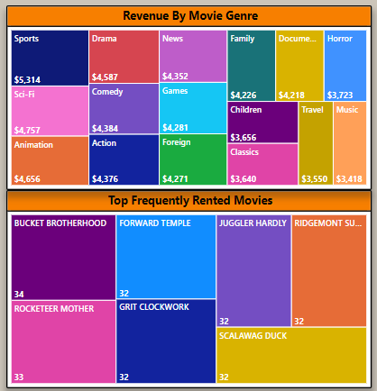
ANALYSIS & INSIGHTS
Customers Rental Behavior Cont.
Movies like Bucket Brotherhood, Grit Clockwork, Scalawag Duck, Hobbit Alien, Zoro Ark etc. are amongst the top frequently rented movies across Sakilla stores around the globe, these frequent rentals and higher return dates indicates high customer’s satisfaction, as its shows that customers enjoy their contents and are willing to pay extra rental charges for them.
Furthermore, movie category/genre also plays a big role in the overall customer rental behavior, as movies in the Sports category/genre generated the highest revenue, with Sci-Fi and Drama, ranking 2nd and 3rd respectively, thus indicating high customer demand for these genres and subsequent customer satisfaction.
Although the revenue margins from the entire movie genres/categories are quite minimal, meaning that customers are happy to rent movies with any of the above categories/genre, which is a good indicator for the business model and growth moving forward.

Slide 9
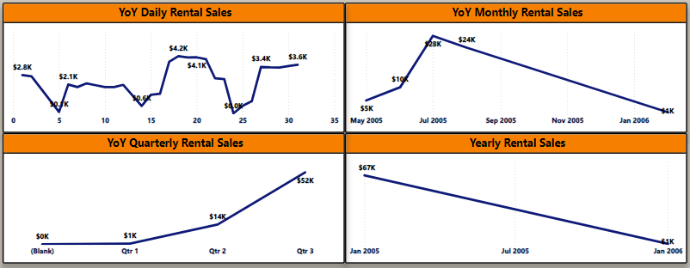
ANALYSIS & INSIGHTS
Time Series Analysis
This shows Revenue generated by the Clients Business over time, broken down by Days, Months, Quarterly and Yearly.
Sales were down at the start of the year 2005, with a slow but steady rise in April to June, and then a sudden spike in July and August of that year.
These sales pattern can be traceable to SEASONALITY BOOM, as the months of July and August Globally are usually SUMMER HOLIDAYS, particularly in the Western world.
This mean that customers are less busy and have extra time to stay at home with their families to watch and enjoy some interesting movies which will aid in strengthening the family bonds, hence the need to patronize movie rental services during this period.
NOTE: 98% of the data provided by or client has most of the transactions business carried in the year 2005, as year 2006 just had only 2 months (January and February) prior to contacting our services to carry out business analysis on their Businesses and Assets.

Slide 10



“
RECOMMENDATIONS
01
02
03
04
Focus on High-Revenue Genres
Genres like Sports, Sci-Fi, and Animation generate the highest revenue. Consider acquiring more titles within these genres to boost rental revenue.
Stock up More Copies of Popular Movies
Given the high rental frequency of titles like "BUCKET BROTHERHOOD" and "ROCKETEER MOTHER," it would be beneficial to stock additional copies of these popular titles to meet demand and avoid stockouts.
Loyalty Programs for High-Value Customers
Customers like ELEANOR HUNT and KARL SEAL, who have a high rental frequency and total spending, should be targeted with loyalty programs, personalized offers, and exclusive discounts to encourage continued patronage.
Target Inactive Customers
Implement strategies to re-engage customers who have not rented in a while, such as sending promotional emails or offering discounts on their next rental.
”
Business Strategies
Business Strategies
Customer Satisfaction
Customer Churn
10

Slide 11




RECOMMENDATIONS
05
06
07
08
Investment Opportunities
Consider expanding into areas where there’s little or no rental services, particularly in Africa and Australia, as these might be places to which our churned customers may have relocated to, as well as targeting other potential new customers in these areas.
Regular Inventory Audits
Conduct regular audits to track the availability of DVDs and identify any discrepancies or losses promptly.
Effective helps in bridging the gaps that might arise between demand and supply.
Customer Feedback
Collect feedback from customers who churn to understand their reasons, know the areas to improve on and address any service gaps or issues to ensure customer retention.
Optimize Inventory Levels
Ensure that the inventory levels of high-demand movies are sufficient to meet customer needs, and consider reducing the stock of less popular titles to optimize storage and costs.
”
Customer Retention
Investment Opportunities
Inventory Management
Inventory Management
11

Slide 12


THANK
YOU
Ojoh Chiemele David
Dojslife@gmail.com.com

